Slide 1

Experimentation and Tuning in the Cloud

Slide 2
Outline
Scientific Method
Testing an Hyptohesis
Tuning and Experimenting on the Cloud

Slide 3
Science
“Knowledge or a system of knowledge covering general truths or the operation of general laws especially as obtained and tested through scientific method”
Merriam-Webster.

Slide 4
Scientific Method
“Principles and procedures for the systematic pursuit of knowledge involving the recognition and formulation of a problem, the collection of data through observation and experiment, and the formulation and testing of hypotheses “
Merriam-Webster

Slide 5
Science
“Science is our most potent invention because it has given us a method to keep reinventing it. All our collective knowledge and expertise (that’s science) began with relatively simple arrangements of information. The simplest organization was the invention of the fact. Facts became codified not by science, but by the European legal system in the 1500s. In court lawyers had to establish agreed-upon observations as evidence that could not shift later. Science adopted this useful innovation. Over time, the novel ways in which knowledge could be ordered increased. This complex apparatus for determining the factual correctness of information, and relating it to old knowledge, is what we call science. “
K.Kelly, The Scientist, 2010.

Slide 6
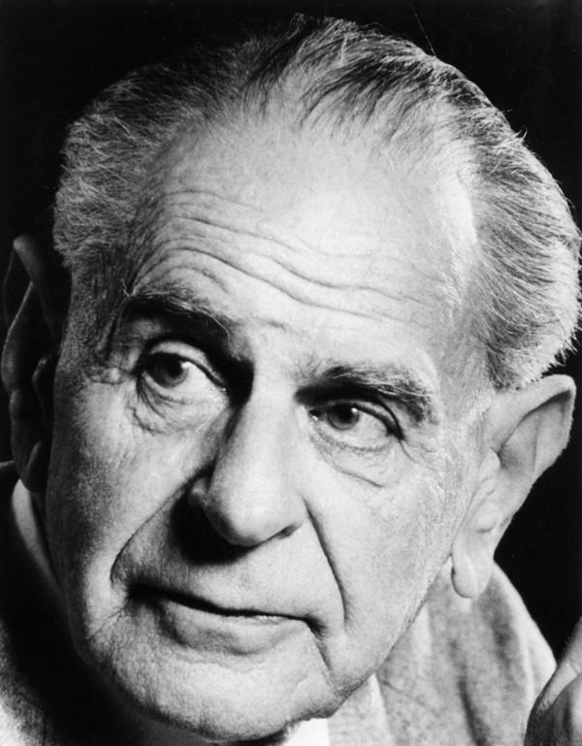
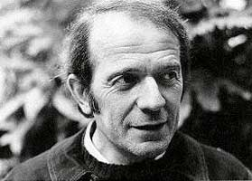
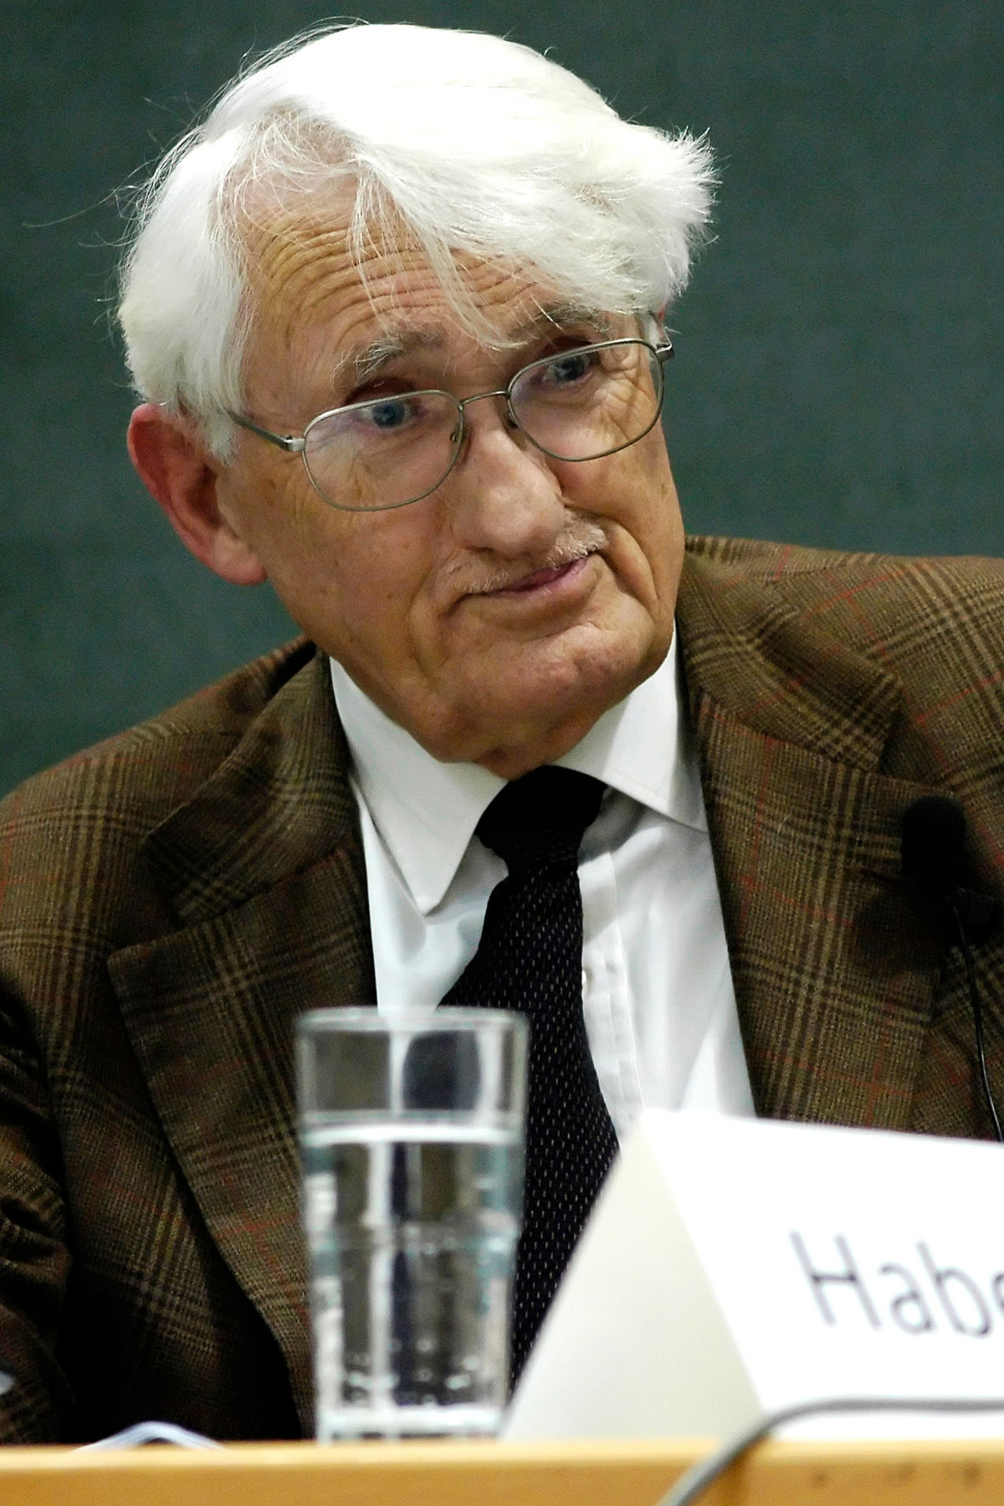
Sidebar#1: Popper vs. Postmodernists vs. Habermas
“The abstract does not explain, but must itself be explained; and the aim is not to rediscover the eternal or the universal, but to find the conditions under which something new is produced” G.Deleuze
“Science can only be comprehended epistemologically, which means as one category of possible knowledge, as long as knowledge is not equated either effusively with the absolute knowledge of a great philosophy or blindly with scientistic self-understanding of the actual business of research.”
J. Habermas
“In so far as a scientific statement speaks about reality,
it must be falsifiable; and in so far as it is not falsifiable,
it does not speak about reality.”
K.Popper

Slide 7
Sidebar #2: Does Data = fact?
“A datum may also be a fact, just as a fact may be
evidence. But ... the existence of a datum has been
independent of any consideration of corresponding
ontological truth. When a fact is proven false it ceases
to be a fact. False data is data nonetheless.”
-­‐-­‐ Daniel Rosenberg (2013) “Data before the Fact”

Slide 8
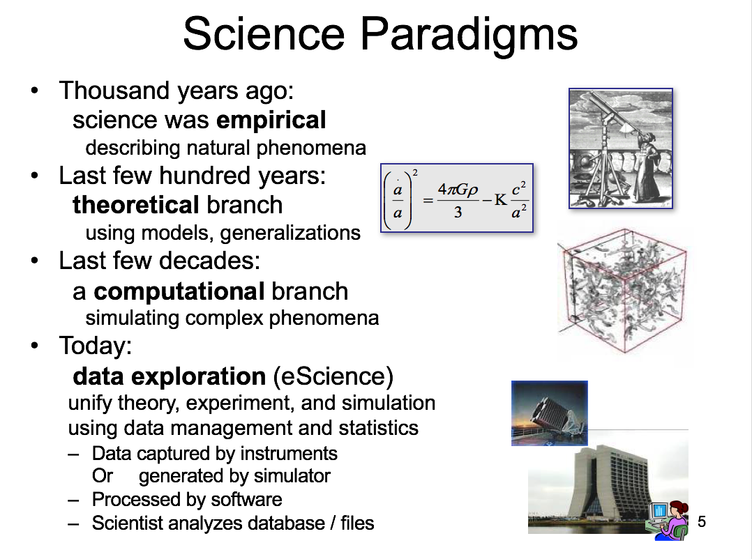
Evolution of the Scientific Method
Jim Gray, eScience: The Next Decade will be Exciting

Slide 9
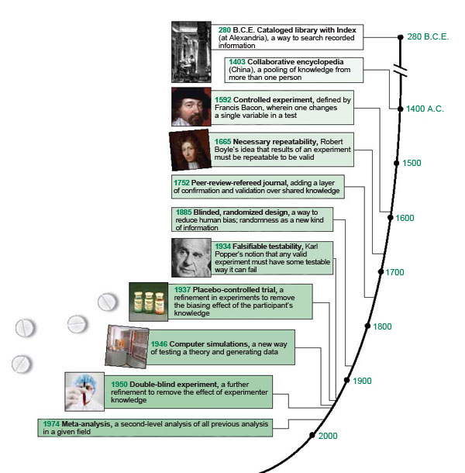
Evolution of the Scientific Method
“Principles and procedures for the
systematic pursuit of knowledge
involving the recognition and
formulation of a problem, the
collection of data through
observation and experiment,
and the formulation and
testing of hypotheses “

Slide 10
Outline
Scientific Method
Testing an Hyptohesis
Tuning and Experimenting on the Cloud

Slide 11
How to test an hypothesis?
(1) Experimental Design
(2) Statistics
(3) Reproducibility

Slide 12
Experimental Design
System
Workload
Metrics
Experiments

Slide 13
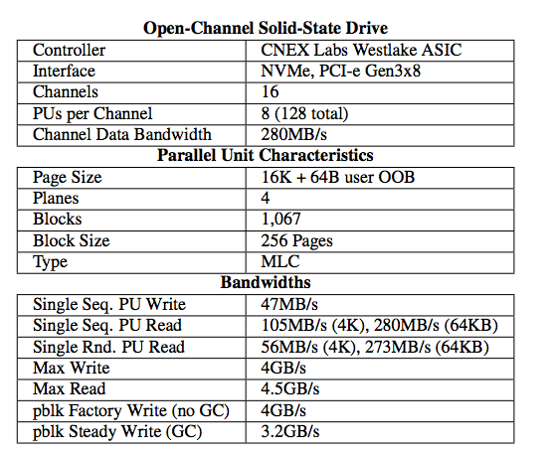
Experimental Design (System)
System
Workload
Metrics
Experiments
System
System parameters
k parameters;
l levels per parameter.

Slide 14
Experimental Design (Workload)
System
Workload
Metrics
Experiments
Workload
System
Synthetic vs. trace-based vs. actual workloads

Slide 15

Experimental Design (Metrics)
System
Workload
Metrics
Experiments
Workload
System
Metrics
What to measure and how?

Slide 16
Experimental Design (Metrics)
System
Workload
Metrics
Experiments
Workload
System
(k parameters;
l levels per parameter)
Metrics
Brut force: k! experiments
2^{k} design: assume a default level for each parameter.
vary a single parameter (factor) at a time, all others are default

Slide 17
How to test an hypothesis?
(1) Experimental Design
(2) Statistics
(3) Reproducibility

Slide 18
Example
Hypothesis
System throughput for web service A differs significantly when P = L0 and when P = L1
Experiment
Execute web service A on System S with P = L0
Execute web service A on System S with P=L1
Measure throughput in both cases

Slide 19
Example
Hypothesis
System throughput for web service A is higher when P = L0 than P = L1
Experiment
Execute web service A on System S with P = L0
Execute web service A on System S with P=L1
Note that we assume that P is the ONLY factor
=> We control that nothing else varies across experiments

Slide 20
The case for statistics
Run the experiments once?
Run the experiments N times?
How large should N be?
How to interpret collection of results

Slide 21
The case for statistics
Statistics to the rescue:
Consider that a collection of experiment results constitute a sample of an underlying distribution
Use (robust) statistics to test null-hypothesis:
Null hypothesis: no significant difference between two specified populations => always two populations with 2k experimental design

Slide 22
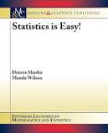
Is the Coin Fair?
You toss a coin 17 times and it comes up heads 15 out of 17 times.
How likely is it that coin is fair?
Could look up Gaussian approximations to Binomial processes. Maybe you’ve forgotten…
Or…
Statistics is Easy, D.Shasha

Slide 23
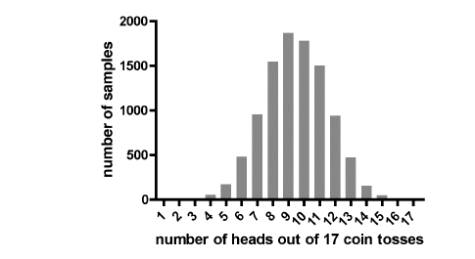
Is the Coin Fair?
You could do the following 10,000 times: toss a fair coin 17 times and count how many times you end up with 15 or more heads.
Statistics is Easy, D.Shasha

Slide 24
Is this Practical?
Takes under a second with your computer.
Is this cheating? No, in the spirit of our times: solve differential equations with Euler’s method.
Is it better? Yes, because more robust, easier to reason about, handles skewed distributions (e.g. average salary of $50,000 with variance of $15,000 gives non-zero probability of negative salary).
Statistics is Easy, D.Shasha

Slide 25
What is the Result?
Something like 9 out of 10,000 times, get 15 heads in 17 tosses.
This gives a “p-value” of 9/10000.
P-value is the probability that the outcome observed would have happened by chance if the coin truly were fair.
Smaller p-value means less likely that the “null hypothesis” (coin is fair) is true.
Statistics is Easy, D.Shasha

Slide 26
How to test an hypothesis?
(1) Experimental Design
(2) Statistics
(3) Reproducibility

Slide 27


Reproducibility
http://www.acm.org/publications/policies/artifact-review-badging
“The measurement can be obtained with stated precision by a different team, a different measuring system, in a different location on multiple trials. For computational experiments, this means that an independent group can obtain the same result using artifacts which they develop completely independently.”
ACM
Results reproduced
Results replicated

Slide 28
Outline
Scientific Method
Testing an Hyptohesis
Tuning and Experimenting in the Cloud

Slide 29
Tuning and Experimentation
Tuning is the activity of making a system run faster

Slide 30
Tuning and the Scientific Method
Given a performance problem:
Formulate hypothesis concerning (a) where the problem comes from and (b) how to fix it
Design experiments for (a) and (b)
Interpret the results

Slide 31
Tuning Process
Observe the system
Formulate, alter, expand, reject hypothesis
Define and run experiments

Slide 32
Experimenting in the Cloud
What is the system?
What are the parameters?
Can the parameters be controlled? How?

Slide 33
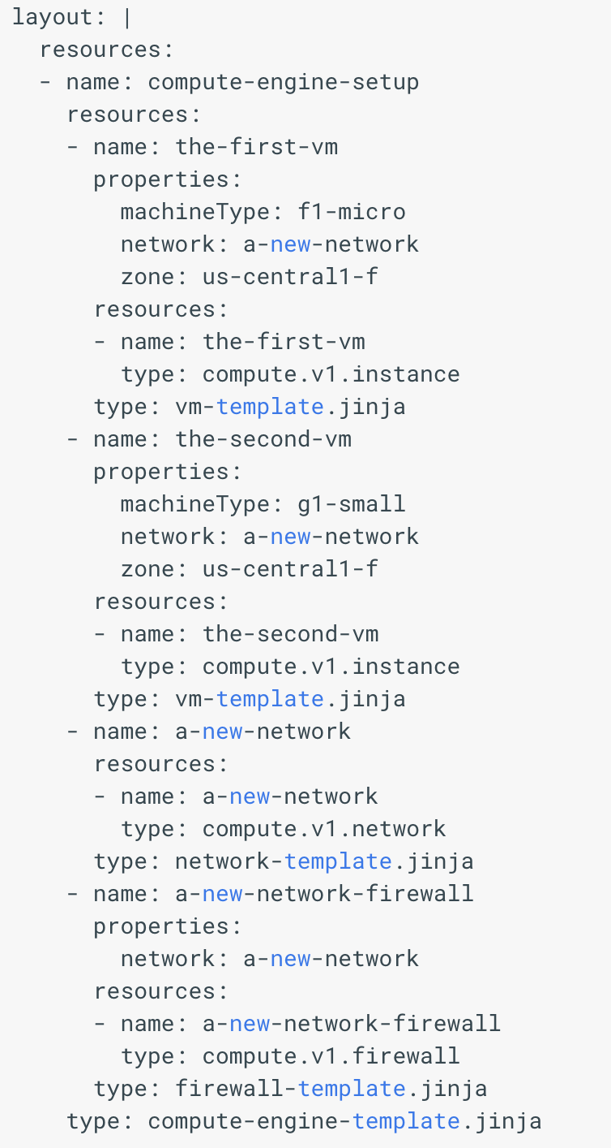
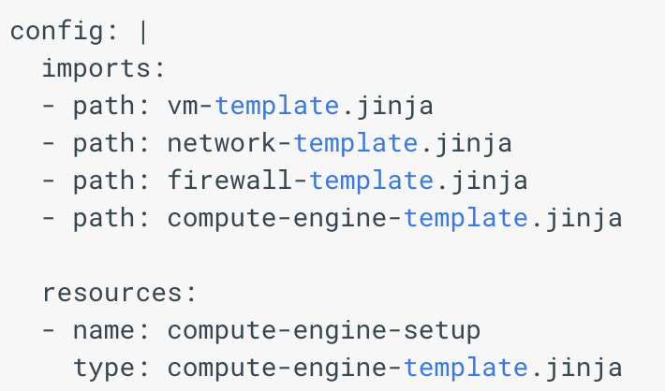
Manifests on the Google Cloud Platform
https://cloud.google.com/deployment-manager/docs/deployments/viewing-manifest
From config file …
… to deployment layout.

Slide 34
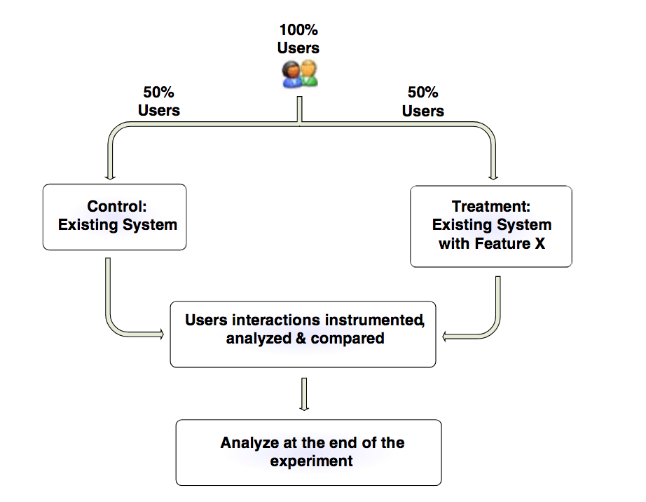
A/B Testing

Slide 35
Implemeting A/B Testing
Randomization
Assignment method
Reporting

Slide 36
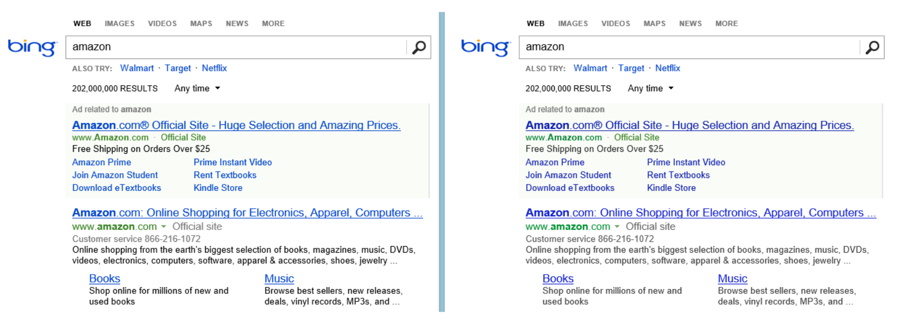

Interpreting A/B Tests
http://www.exp-platform.com/Documents/2014%20experimentersRulesOfThumb.pdf

Slide 37
A/B Testing
Short term vs. longer term effect
Quantitative measures, but no explanations
Twyman’s law
“If a statistic looks interesting or unusual it is probably wrong.”

Slide 38
Take-Aways
The scientific method underlies performance evaluation and tuning: formulating hypothesis, designing/running experiments and interpreting results.
Experimentation has 4 components: system, workload, metrics, experiment design.
2^{k} experimental design is most common
Statistics needed to interpret results: testing of null-hypothesis
Controlling parameters is a challenge in the cloud. A/B testing is the dominant form of experimentation

